Slide 1
Keep Calm and Make Music
One Hit Wonder Workshop
Give Me Courage

Slide 2
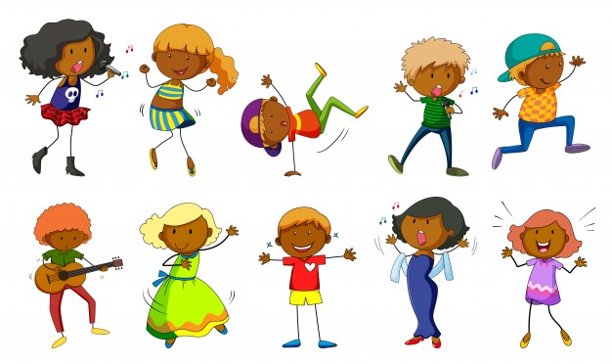
Getting Creative with a Song

Slide 3
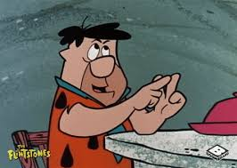
Give me Courage….the song
Listen to the song
How could you describe this song? Make marks on paper to show the sounds in this song (are they smooth or spiky? what colours are they?)
Write your key words in different colours on a piece of paper
Count how many times you hear…
courage
brave
dive in
Listen again and move your feet in time with the steady beat, then try tapping your knees in time to the steady beat.
How else could you keep the steady beat?
Listen again, notice the drone – the same low note repeating throughout the song. Sometimes it has a faster rhythm – do you notice when it changes? Does it change back?
Listen again and see how much of the song you can sing along with
You can listen more
than once

Slide 4
Give me Courage….the movie!
Click play on the blue square to watch some real courage

Slide 5
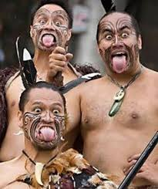
Being brave…
…keep a brave face…
This song has a call and echo section – hoi! hoi!
Find someone else to call / echo with – come up with your own brave sounding word and “be brave” calling it (try hoo / haa if you can’t think of your own)
Make strong, scary faces in the mirror
Practise making different brave stances
while you play and sing the song
(arms / legs / face)

Slide 6
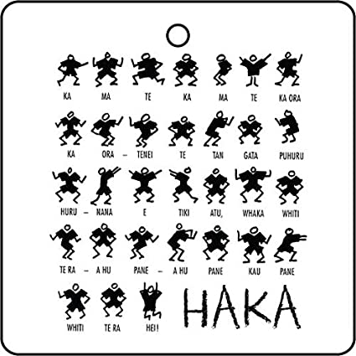
Watch this clip of a HAKA.
It uses strong, rhythmic actions alongside chanting You are going to work out a “HAKA” to perform with the Courage song
First, work out a sequence of
strong / brave poses
Then, decide to hold / repeat the
pose rhythmically for each phrase
Now, create a sequence or
pattern of moves to using these
poses to accompany the song
Practise and get it ready to perform

Slide 7
…and show yourself off…
Share your performance with someone – maybe you could record it on an iPad and share it with someone else in your family or class.
If you’re at home, maybe you could perform whilst face-timing a friend or relative
Enjoy !!

