Slide 1
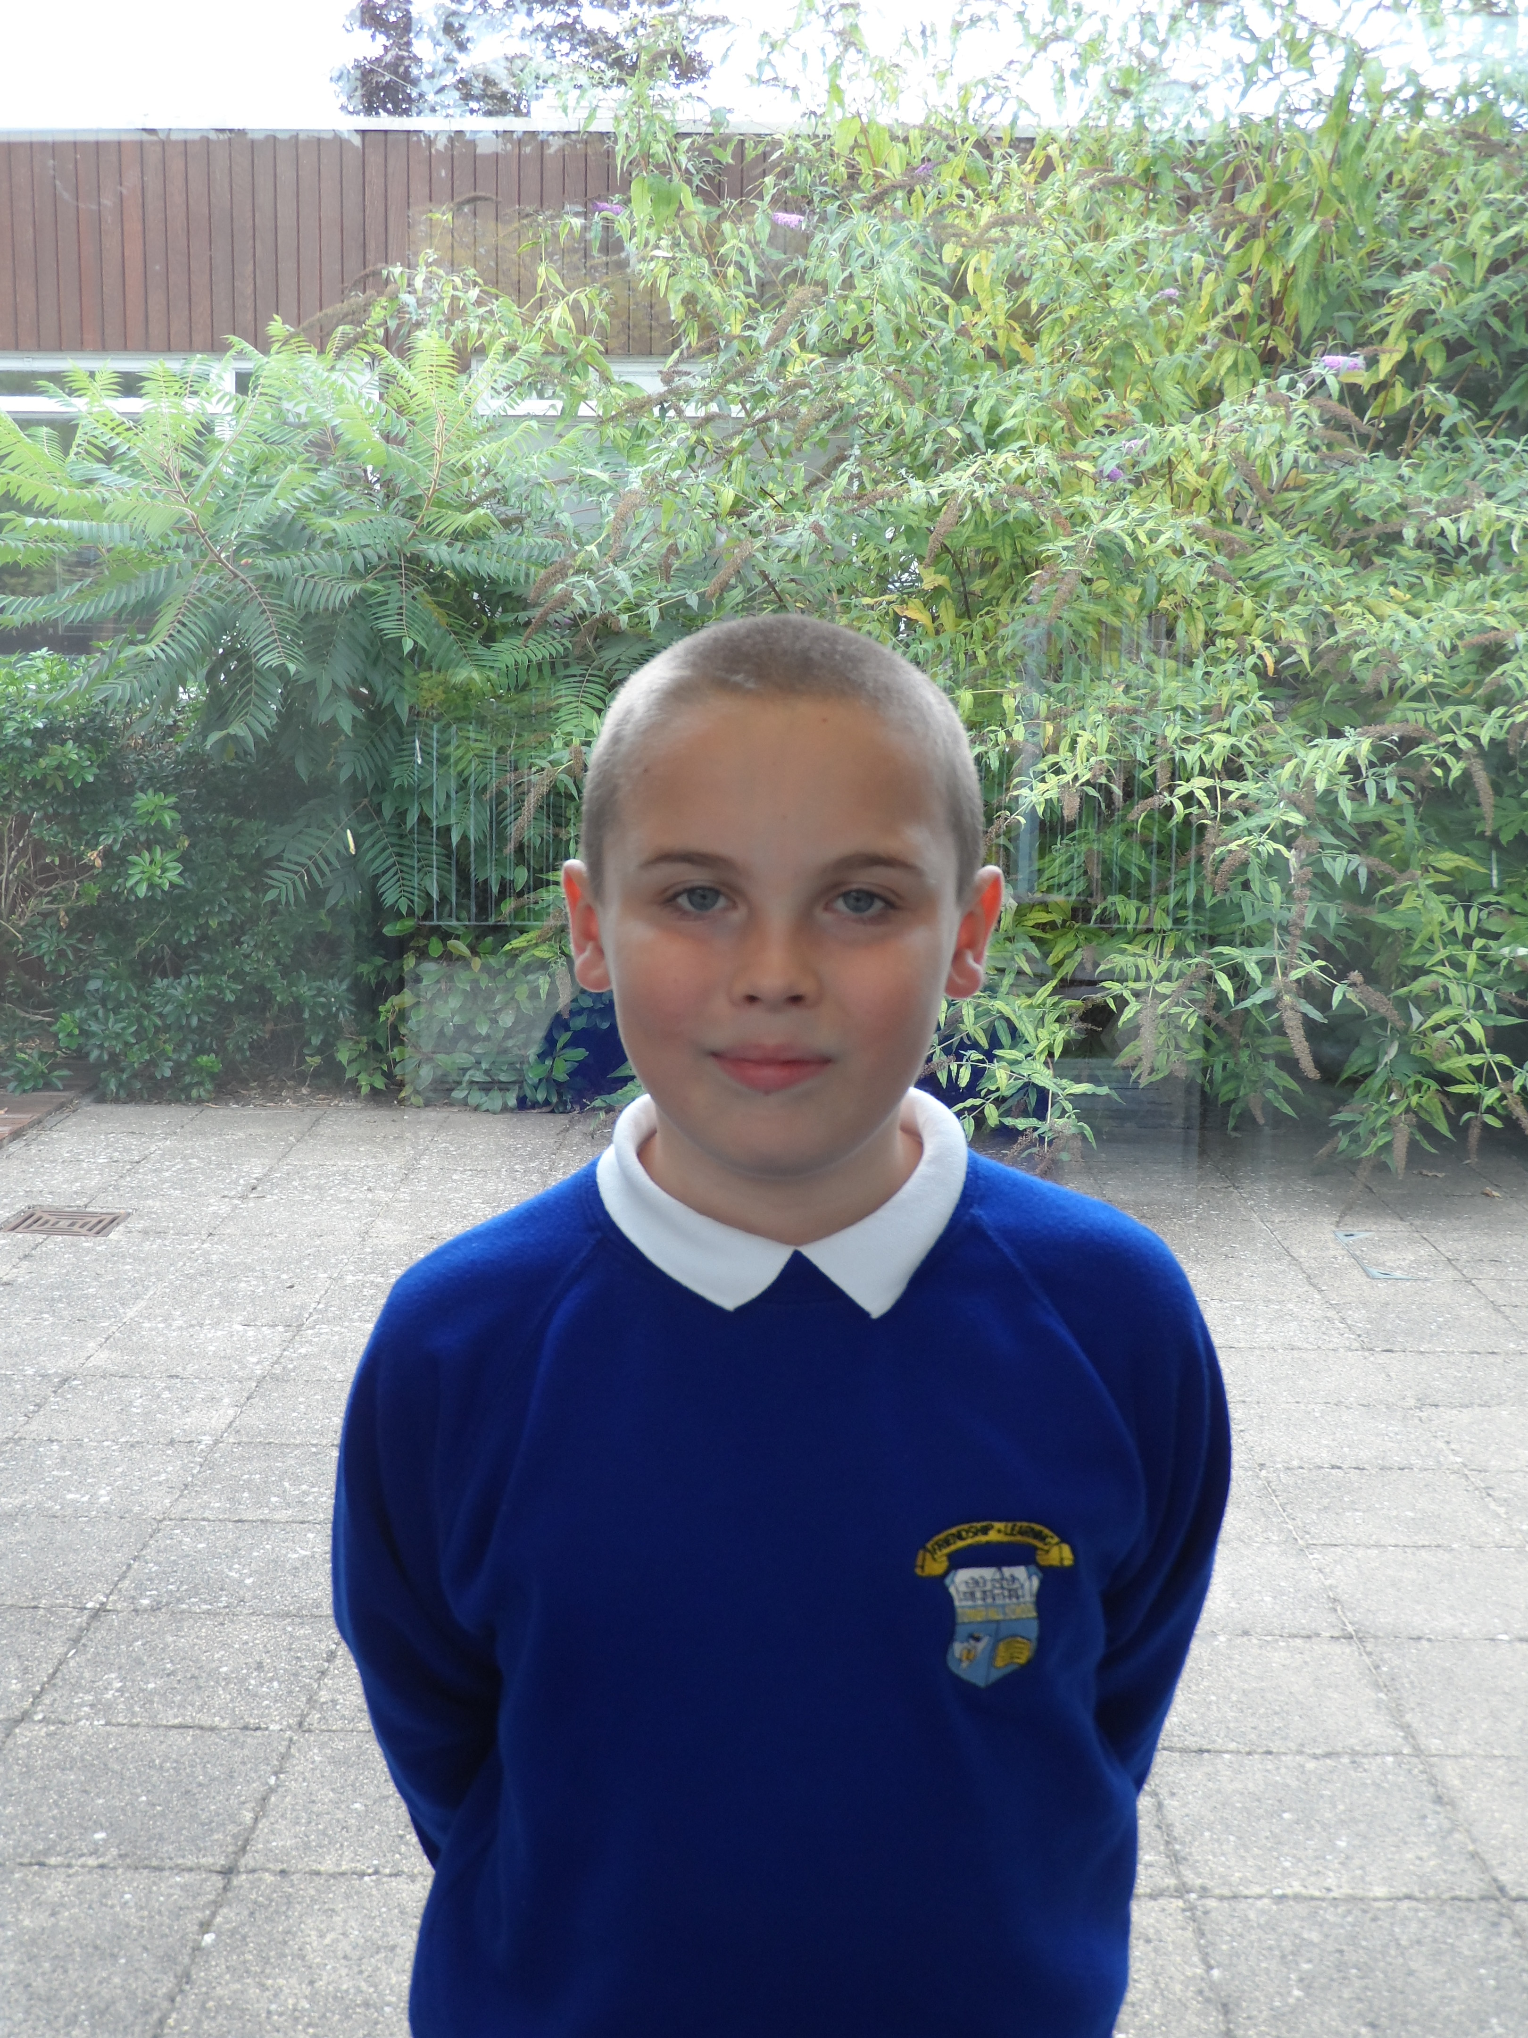
2017 School Council Election
This is a photo of me in year 5.
Why should you vote for me?

Slide 2
About me
Member of Year 6
Blue house captain
Responsible

Slide 3
Plans for the future
Here are a few:
Hire more digital leaders
Co-operate with the digital leaders
Defend the school e.g. the stone throwing incident!

Slide 4
THE VERY IMPORTANT…

Slide 5
Vote!
Tower Hill
It always has

Slide 6
This school is…

Slide 7
The end…
I hope you vote for me as what I’m about to say is very important. Here we go:

