Slide 1
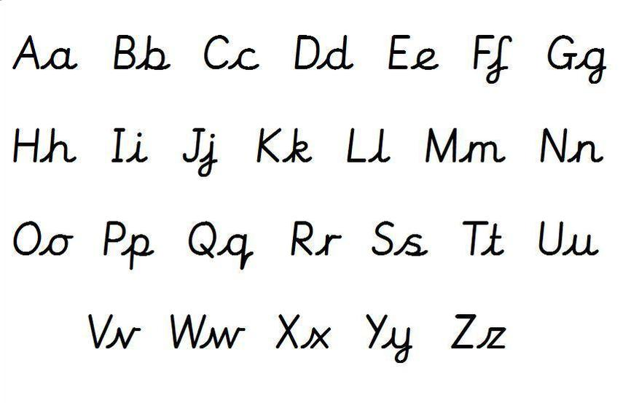
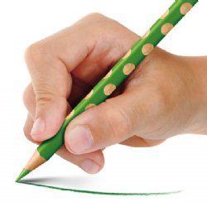
Handwriting Information for Parents

Slide 2
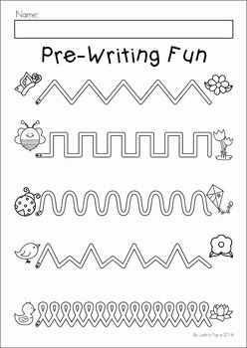
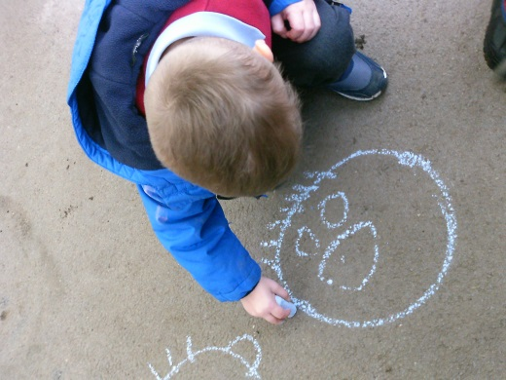
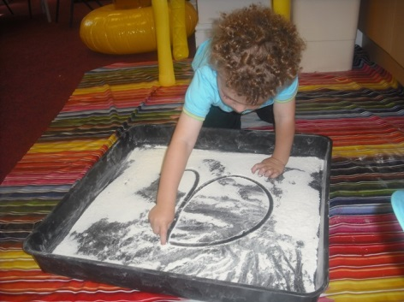
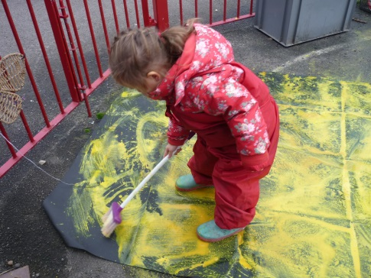
Handwriting Development
Mark Making – children experiment with lines, dots, dashes etc. to make marks
Gross motor to fine motor skills
Forming letters in the right direction , starting and finishing in the right place.
Notes:
Handwriting is a developmental process which starts when the children are very young. They pick up a pen, pencil, chalk etc and begin to make marks which we see as scribble and it means something to them. These pre-handwriting patterns are the first, very important step in handwriting as these lines, dots etc. are the shapes and strokes the children need ready to form the letters. As the child develops, the marks the children make go from big to small. The movements will go from big uncontrolled movements to smaller and more fine movements as the gross and fine motor skills develop.
Big uncontrolled movements to make big marks – chalk on pavements, paintbrushes and water, coloured markers on big paper, sand and water play develop the shoulder, upper arm muscles which need to be developed before moving to the smaller more controlled and finer handwriting.
Pre-writing patterns – lots of sheets on the internet – twinkl! Lots of squiggly lines horizontal and vertical, loops, zig zags to get the children used to the push and pull of the writing implement before forming letters.
Once the children have got to grips with forming all of the pre-writing patterns they can then be moved onto the forming of the letters. This doesn’t mean with a pencil and pen sat at a table necessarily, it can be with paintbrushes, markers, in sand, shaving cream, glitter etc. The key focus is starting in the right place and finishing in the right place.

Slide 3
Handwriting Seats!
Comfortable sitting position to be able to move their hands and arms freely.
Core strength
https://www.youtube.com/watch?v=iYYNhVwvGJs&list=PLfW4cqa3-nhu3ANsP8AWatFlkGWXvhFwa
Notes:
To be able to write for a significant amount of time it is important that children are in a comfortable seating position that allows the arms and hands to move freely helping with their handwriting. Being comfortable increase the quality and the quantity of the writing the children produce.
Obviously I understand all of these things are very specific – the key things we encourage during handwriting lessons in class are: make sure chairs are tucked in, feet on the floor and the hand they are not writing with is on the table holding the piece of paper or the book.
Show video – Type into Youtube – Westfields Yateley and a playlist of videos called Handwriting will appear. https://www.youtube.com/watch?v=iYYNhVwvGJs&list=PLfW4cqa3-nhu3ANsP8AWatFlkGWXvhFwa
The children also need good core muscle strength. If the child is fidgeting, jumping up and down on their chair, leaning over on the table they need to work on their core strength. This links back to the gross motor skills they should have been developing in the younger years, in physical activity etc. Good posture requires the large muscle groups – pelvis, trunk, shoulders and arms need to work in a coordinated way. Strong and well developed gross motor skills gives the body a stable base (core strength) required for balance and stability, supporting coordination skills. Give out Posture Activities sheet.

Slide 4
Paper Position
Notes:
Paper position is something which does not get thought about as important, but just like the handwriting seat, the position of the paper can make a big difference to the handwriting experience and comfort.

Slide 5
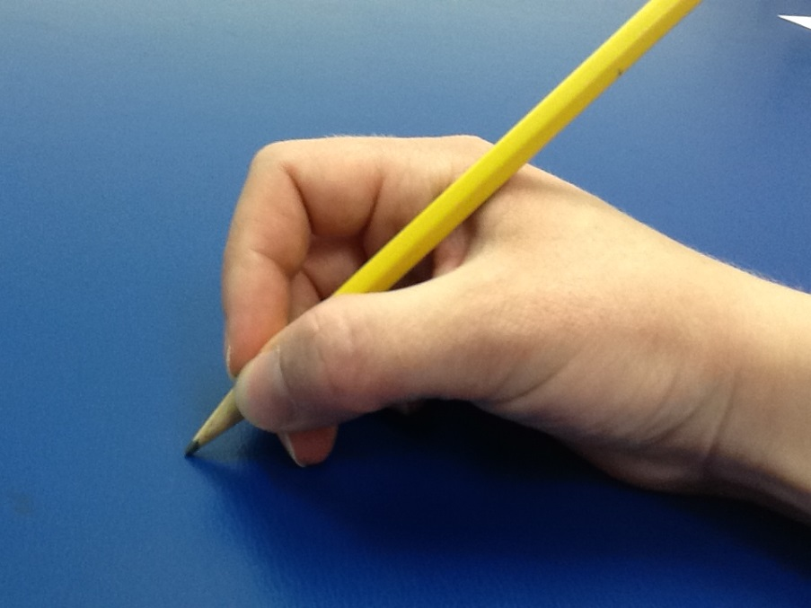
Pencil Grip
http://www.teachhandwriting.co.uk/handwriting-pen-grip.html
Notes:
Holding the pen or pencil correctly allows the fingers and wrist to move freely, without putting strain on the hand, helping to improve handwriting and making it more comfortable. The picture shows the progression of children’s pencil grip. In YR as soon as the children come in to school they are encouraged to use the froggy grip, also known as the tripod grip. The children are told their fingers are the froggy’s legs which bend. Correcting the child’s pencil grip will take time so just be patient, constant encouragement, keep repeating it every time you handwrite with the children and lots of positive praise, stickers, rewards etc.

Slide 6
Getting ready to write!
Ten Fingers
I have ten fingers
And they all belong to me,
I can make them do things-
Would you like to see?
I can shut them up tight
I can open them wide
I can put them together
I can make them all hide
I can make them jump high
I can make them jump low
I can fold them up quietly
And hold them just so.
http://www.teachhandwriting.co.uk/handwriting-warm-up-exercises.html
Notes:
Little poem to do with the children before you do handwriting with them – something fun and practical to get their hands warmed up.

Slide 7
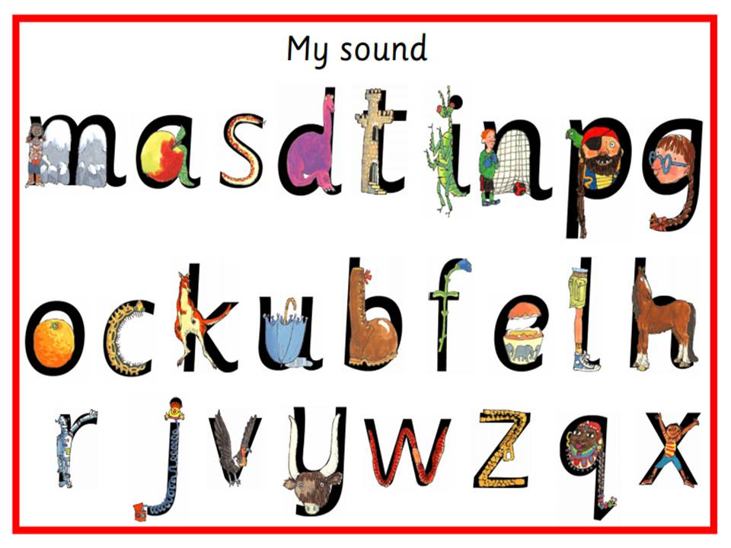
Handwriting at Tower Hill
YR – mark making, letter formation, pencil grip
Notes:
When the children join us in YR they are encouraged to mark make as much as possible with as many different materials. The children then progress to forming their letters properly, starting and finishing in the right place. The children are taught how to handwrite in print. This follows the program of RWI phonics that we implement in school, the way we teach the children to recognise letter sounds, how to blend sounds together to read words. In the RWI program each of the letters have their own handwriting phrase which the children are taught to say as they form the letters. They are very catchy and easy to say and it makes the forming of the letters fun and easy to remember. Children in YR practice their handwriting every day during their RWI sessions which are daily and then they also have discrete/separate handwriting sessions at least 3 times a week in the afternoons where they practice letter formation, number formation, their name, cvc words, tricky words etc.

Slide 8
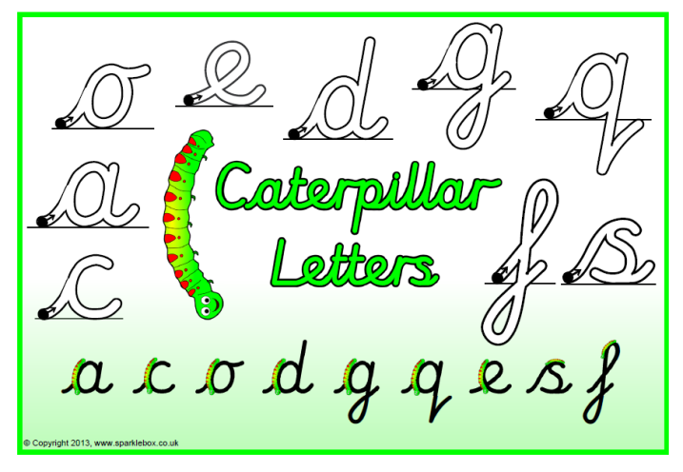
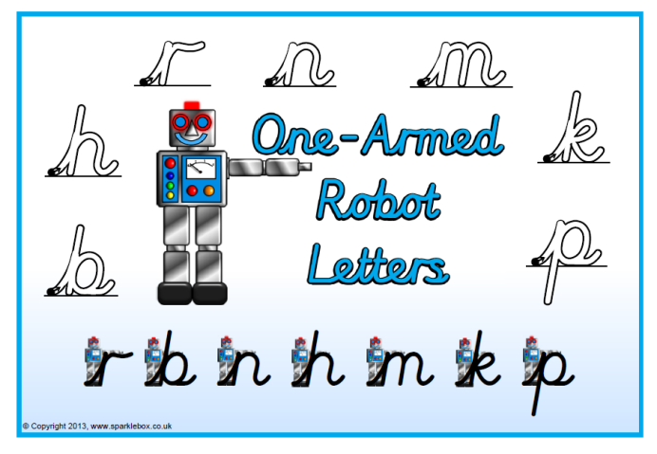
Handwriting at Tower Hill
Y1 – Cursive script, RWI phrases, lead ins and lead outs, letter families.
Notes:
As the children become secure with their letter formation in YR, forming the letters in the right way, starting and finishing in the right place then in the Summer term the children are then encouraged to move onto cursive script. This is then what is expected in Y1. As the chln join Y1 we still practice every letter of the alphabet however we move onto pre-cursive, teaching the letters with lead ins and lead outs and introducing the joining of the letters. We still use the RWI phrases however we start and end with a flick. We teach each letter individually with a flick in and flick out and we group these into letter families. Teaching the letter families helps the children understand which letters are formed with the same movements and also helps with letter reversals such as b and d.

Slide 9
Handwriting in Y1
Notes:
In Year 1 we use the handwriting books with the 2 different coloured lines. This encourages the chln to form their letters with the correct sizing, allowing for the correct formation of ascenders and descenders. We teach handwriting every day, straight after lunch for 30 mins. A typical handwriting lesson would consist of writing the date in cursive, teaching two letters from a particular letter family, pre cursive and then joined up and then writing a simple sentence which include words with the two letters just taught.

Slide 10
Handwriting Homework
No prep for you!
Each child will have:
Named zip wallet
Handwriting book
Sharp pencil
Cursive card to copy
Every Tuesday and Thursday to be returned the next day.
No longer than 15 mins maximum!
Raffle tickets
Notes:
This is where we need your help. The more the children practise their handwriting, the better and easier it will become for the children. Miss Wright and I have put together a pack for each of your children which will be sent home on a Tuesday and a Thursday afternoon. This homework is not time-consuming and we have made it as easy for you as possible. Each child will have … All we would like from you is to sit with your child for 15 mins maximum and prompt, encourage, praise, support your child as they copy the cursive card they have been sent home with. If you want to practice some of the writing patterns beforehand that is great, if you want them to do more that would be amazing! But all we are wishing for is for the children to copy the sentences or short poems we send home in that pack. Your role is to make sure they are concentrating, starting in the right place, forming and joining their letters correctly and giving them as much encouragement and praise as possible.
The homework is to be returned the following day, we will then give each child a raffle ticket to be put into a pot in class for each time the handwriting is completed and a second raffle ticket will be given if we can see how hard the child has tried and how beautiful the handwriting is. Obviously we know the children, we see them write on a day to day basis so please don’t be disheartened if you watch you child write and think omg they are never going to get two raffle tickets because we will know how hard that child has worked and we can tell if that is good for them. It’s a personal handwriting homework and we will honour that.
At the end of the half term we will then draw 5 names from the pot to receive a special handwriting prize. So obviously the more times they do the handwriting homework and the harder they practice, concentration etc. the more raffle tickets they will win.
This will all be explained to the children on Friday and as it will be fresh in their minds we will send the first set of homework on Friday afternoon to be completed over half term and returned the first day back.

Slide 11
Notes:
The purpose of this session was to help you understand how a child’s handwriting journey evolves and how we teach handwriting at school. Handwriting is so important for the children when they move through the year groups, to have an adult be able to read the writing without needing the child to translate for you gives the children such joy and they are proud of it. We want the children to master the art and skill of handwriting at the earliest age possible so they aren’t worried about how to form their letters and how to join them etc. so when they move up into the older year groups where the expectation of the content of the writing is increased massively they can focus on the quality of the content and what they want to write rather than how they going to write. I hope this session has been useful and helpful for you, if you have any questions please don’t hesitate to come and ask me. If you want any more resources, again come and see me and I can find things that would be useful etc.

